Slide 1
Course code
Product
V5R2
V1R1
Wu Yue/wwx291773
2020.05.30
Reviewer/ID
New
Author/ID
Reviewer/ID
Update
Author/ID
Reviewer/ID
Update
Author/ID
Reviewer/ID
Update
Author/ID
Reviewer/ID
Update

Slide 2
Network Management and Maintenance

Slide 3
Network management is the most important task of O&M personnel. Typical management tasks include routine network management, new site deployment, and network troubleshooting. As ICT technologies develop, traditional O&M methods are unable to meet customer requirements because they have the following disadvantages:
Routine management is performed based on SNMP using network management software. SNMP, however, is inflexible in the cloud computing era.
New site deployment is an exhausting task, which is also challenging, especially when a large number of new sites need to be deployed.
Network troubleshooting is challenging for most O&M personnel, and how to systematically troubleshoot faults is also an urgent problem to be addressed.
This course describes the new protocols and methods for routine maintenance, the methods for quick site deployment, and the methods for systematic network troubleshooting.

Slide 4
Upon completion of this course, you will be able to describe:
The disadvantages of the SNMP protocol.
How NETCONF flexibly controls devices.
The advantages of using telemetry to collect device status and performance data.
Northbound RESTful interfaces of the network management system (NMS) and controller.
Zero touch provisioning (ZTP).
How to troubleshoot common network faults.

Slide 5
Network Management
ZTP
Network Maintenance

Slide 6



Traditional Network Management
Network management involves the use of various protocols, tools, applications, and devices to monitor and control network resources, including hardware and software, so as to meet service requirements and network objectives.
Traditional network management can be performed manually or using NMS software.
Manual network management
NMS software-based network management
Network administrator
Network administrator
NMS software
SSH/Telnet
SNMP
Notes:
Manual network management is convenient but has the following disadvantages:
When managing different types of devices from different vendors, network administrators need to memorize a large number of commands and product features, resulting in high O&M costs.
Manual management is inefficient and does not apply to large-scale networks.
Problems cannot be quickly located.
NMS software-based network management has the following advantages over manual management:
SNMP can be used to manage different types of devices from different vendors, lowering the requirements for network administrators.
NMS software can be used to manage large-scale networks.
Faults can be located faster.

Slide 7
Network Management in the Cloud Computing Era
The advent of the cloud computing era brings great changes in network management requirements, which means network management needs to be performed based on content instead of pipes. Network management in the cloud computing era has the following disadvantages:
It is inefficient and complex to manage various types of products from different vendors using NMS software, and automation cannot be implemented.
NMS software cannot detect network performance accurately.
Some new protocols and technologies are developed to solve these problems:
The NETCONF protocol simplifies network configuration.
Telemetry technology greatly improves the accuracy in network performance measurement.
RESTful APIs make network management more open.
Management plane
Built-in Portal in the controller
Third-party BSS/OSS
RESTful API
RESTful API
Control plane
Orchestrate
Control
Manage
NETCONF/SSH
BGP/DTLS
HTTP 2.0 (Telemetry)
Forwarding plane
Notes:
NETCONF is developed based on the Yet Another Next Generation (YANG) model.

Slide 8
Network Management Technologies
SNMP is the most commonly used network management protocol. It used to be very efficient, but is unable to meet the current management requirements due to the following defects:
SNMP cannot configure network devices efficiently and easily.
SNMP has a poor performance in real-time network monitoring.
To address the preceding two problems, the following technologies are developed:
NETCONF: It is designed to offer standard device configuration by using the standard YANG data models. Using NETCONF, the controller can efficiently control devices and quickly deliver configurations.
Telemetry: SNMP uses the query-response mechanism, so it is inefficient in reporting network status. Telemetry technology uses subscription to improve efficiency in reporting device status.
In addition, some enterprises have requirements on the openness of NMS software. To meet these requirements, the NMS software or controller provides open northbound RESTful APIs.
Notes:
The reason why SNMP cannot efficiently configure a network is that different vendors have different implementation models for the same type of access devices and the implementation models correspond to different configuration models. As a result, it is difficult to unify standards.
The reason why SNMP has poor real-time network monitoring performance is that SNMP uses the "query-response" architecture. Frequent queries will cause high CPU usage of network devices.

Slide 9


SNMP Overview
SNMP
NETCONF
Telemetry
RESTful API
SNMP builds a data standard between the device and NMS based on the Management Information Base (MIB) data structure. The NMS uses OIDs to query specific information, such as the CPU usage and memory usage. SNMP queries use the request-response model, but subscription is not supported.
SNMP has certain configuration delivery capabilities. However, it is difficult to implement unified configuration because different vendors have different configuration commands.
Devices directly report locally generated alarms to the NMS.
Device status query
Alarm reporting
NMS
Device
NMS
SNMP trap packet (alarm information)
Device
SNMP query packet (specific OID)
MIB
SNMP reply packet (specific OID)
MIB
MIB
MIB

Slide 10
Disadvantages of the Traditional Configuration Mode
SNMP
NETCONF
Telemetry
RESTful API
SNMP can deliver configurations based on MIBs, but has the following defects:
Configuration is performed separately for each object, not for each service.
Devices are configured separately. Network-level configuration and multi-device configuration collaboration are not supported.
Binary interfaces are difficult to understand.
It is insecure.
Using the CLI or CLI script for configuration is convenient, but still has the following defects:
Different vendors define commands differently. Therefore, scripts need to be customized for different vendors.
The output is unstructured data, which is complex to parse, and the CLI scripts are difficult to configure.

Slide 11



NETCONF Overview
SNMP
NETCONF
Telemetry
RESTful API
The Network Configuration Protocol (NETCONF) resolves the difficulty in configuring devices using SNMP.
NETCONF provides a set of mechanism for managing network devices. To be specific, users can use NETCONF to add, modify, and delete configurations of network devices, as well as obtain the configurations and status of network devices.
NETCONF has three objects:
NETCONF client
NETCONF server
NETCONF message
Management platform
Controller
NETCONF Client
NETCONF
Network
NETCONF Server
Device
Device 1
Device 2
Device 3
Notes:
With the development of automated network O&M, automated service deployment, and SDN and NFV technologies, NETCONF and YANG have been considered the basic capabilities of network devices, and also prove to be the best choice for open programming networks.
NETCONF sessions are carried over SSH and support the heartbeat keepalive and key mechanisms defined by SSH.

Slide 12
NETCONF Implementation - Protocol Architecture
SNMP
NETCONF
Telemetry
RESTful API
NETCONF consists of four layers, which are secure transport layer, messages layer, operations layer, and content layer from bottom to top.
The secure transport layer ensures protocol security. Currently, SSH is the most widely used NETCONF secure transport layer protocol.
Similar to SNMP, the messages layer provides a mechanism for encoding Remote Procedure Calls (RPCs) and notifications.
The operations layer defines the operations for obtaining and editing basic protocol configuration information.
The content layer consists of configuration data, status data, and notification data. Data is classified to facilitate cross-device comparison.
Content layer
Config Data
Status Data
Notification Data
Operations layer
<Get> <Get-config> <Edit-config> <Lock> …
Messages layer
<RPC> <RPC-reply> <Hello>
Notification
Secure transport
layer
SSH
TLS
SOAP
BEEP

Slide 13
Disadvantages of Traditional Network Monitoring
SNMP
NETCONF
Telemetry
RESTful API
Traditional network monitoring uses the SNMP protocol to monitor network performance. SNMP obtains network status information in request-response mode. However, when the SNMP NMS requests a large amount of network status information, a large number of SNMP request packets need to be sent, increasing the query time.
SNMP request and reply packets are processed by the CPU of the device's MPU. Processing a large number of SNMP packets will cause a sharp increase in the CPU usage. On the live network, the smallest SNMP query interval is 5 minutes.
In the cloud computing era, SNMP cannot meet network performance monitoring requirements.
Device
Card 1's NP/ASIC
Interface 1
Card 1's CPU
Status information
Status information
SNMP messages are processed by the CPU of the MPU.
Traffic 1
Interface 2
MIB model
CPU of the MPU
SNMP process
SNMP packet
SNMP packet
Card 2's NP/ASIC
SNMP NMS
Interface 3
Card 2's CPU
Status information
Status information
Traffic 2
Interface 4

Slide 14
Telemetry Overview
SNMP
NETCONF
Telemetry
RESTful API
In the cloud computing era, network status needs to be monitored based on services instead of pipes. In addition, service diversity requires network monitoring to be more flexible.
Traditional networks use SNMP to monitor network status. However, the interval for reporting network status is too long and therefore the actual network status cannot be collected. Telemetry perfectly addresses the defects of SNMP.
Telemetry, also known as network telemetry, is a technology for network monitoring, including packet check and analysis, intrusion and attack detection, intelligent data collection, and application performance management. It has the following advantages:
Supports multiple implementation modes, meeting diversified user requirements.
Collects a wide variety of data with high precision to fully reflect network status.
Continuously reports data with only one-time data subscription.
Locates faults rapidly and accurately.
Leverages big data for data analysis and presentation.
Controller
Collector
Use NETCONF
to deliver telemetry subscription configurations.
Use telemetry
to report data.
Second/Subsecond-level
Network device
Notes:
With the popularization of networks and emergence of new technologies, the network scale is growing, network deployment is increasingly complex, and users have higher requirements on service quality. To meet user requirements, network O&M must be more refined and intelligent. Network O&M are faced with the following challenges:
Ultra-large scale: A large number of devices need to be managed and massive amount of information needs to be monitored.
Quick fault locating: Users want faults to be located within seconds or even subseconds on complex networks.
Refined monitoring: Various types of data needs to be monitored at a finer granularity to reflect the network status completely and accurately. With the monitoring information, possible faults can be predicted, providing a sound foundation for network optimization. Network O&M involves monitoring not only traffic statistics on interfaces, packet loss on each flow, CPU usage, and memory usage, but also the latency and jitter of each flow, latency of each packet on its transmission path, and buffer usage on each device.
The collector, analyzer, and controller are components of the network management system.
The collector receives and stores monitoring data reported by network devices.
The analyzer analyzes the monitoring data received by the collector and processes the data, for example, displays the data on the graphical user interface.
The controller uses NETCONF to deliver configurations to devices, so as to manage network devices. The controller can deliver configurations to network devices based on the analysis data provided by the analyzer and adjust the forwarding behavior of network devices. It also controls the data that the network devices need to sample and report.

Slide 15
Telemetry Implementation - Subscription/Push Mechanism
SNMP
NETCONF
Telemetry
RESTful API
A telemetry collector subscribes to device status in static or dynamic mode, and devices periodically report status information to the collector.
Telemetry assembles multiple pieces of status information into a packet, reducing bandwidth and hardware resource consumption.
Obtain status information through SNMP
Obtain status information through telemetry
Obtain 10 pieces of status information
Obtain 10 pieces of status information
SNMP packet
SNMP packet
Telemetry
packet
Telemetry
packet
Network device
Request the first piece of status information
SNMP NMS
Network device
Subscribe to 10 pieces of status information that is to be sent at an interval of 10 seconds.
Telemetry collector
Reply with the first piece of status information
Request the second piece of status information
Push the first piece of status information
Reply with the second piece of status information
Push the second piece of status information
. . .
Push the third, fourth, fifth piece of status information
. . .
Request the tenth piece of status information
Push the tenth piece of status information
Reply with the tenth piece of status information

Slide 16
Telemetry Implementation - Distributed Processing
SNMP
NETCONF
Telemetry
RESTful API
Telemetry data is no longer processed by the CPU of the MPU. Instead, the device can directly send telemetry data to the collector through the NP/ASIC chip or the CPU of its card. This prevents high CPU usage of the MPU when the device needs to process a large amount of status information.
The NP/ASIC chip of a card sends status information.
Device
Card 1's NP/ASIC
Card 1's CPU
Interface 1
Status information
Traffic 1
Status information
Interface 2
The CPU of a card sends status information.
CPU of the MPU
Telemetry collector
Card 2's NP/ASIC
Interface 3
Card 2's CPU
Traffic 2
Status information
Status information
Interface 4

Slide 17
Telemetry Implementation - Data Collection by Hardware Chips
SNMP
NETCONF
Telemetry
RESTful API
Status information can be collected through software using the CPU of a card. In this mode, information can be collected every second.
Status information can be collected through hardware using the NP/ASIC chip of a card. In this mode, information can be collected every 100 ms.
Device
Collect information through the CPU of a card.
Card 1's NP/ASIC
Card 1's CPU
Interface 1
Status information
Status information
Traffic 1
Interface 2
Collect information through the NP/ASCI chip of a card.
Card 2's NP/ASIC
Interface 3
Card 2's CPU
Traffic 2
Status information
Status information
Interface 4

Slide 18
NBI Overview
SNMP
NETCONF
Telemetry
RESTful API
Northbound interfaces (NBIs) make network management more flexible. Some customers have self-developed network management platforms. To reduce the learning costs of maintenance personnel, network management software needs to provide open NBIs to facilitate secondary development of customers.
There are many types of NBIs, such as SNMP, CORBA, XML, TL1 and REST NBIs, among which SNMP and REST NBIs are most widely used on the live network. However, due to many problems of SNMP, more REST interfaces will be used on SDN controllers in the future.
Third-party management platform/Controller
Northbound interfaces: SNMP, CORBA, XML, REST, etc.
NMS software/Controller
Southbound interfaces: SNMP, NETCONF, SSH, etc.

Slide 19
REST Overview
SNMP
NETCONF
Telemetry
RESTful API
The Representational State Transfer (REST) service uses the HTTP service as the communication protocol and uses HTTP primitives to express service requests. REST provides the following functions:
Presentational: All data generated during network O&M needs to be carried or presented in a corresponding manner. For example, all transactions on a network can be abstracted as resources in the NMS software, and each resource has a unique Uniform Resource Identifier (URI).
State transfer: An interaction between a client and server causes resource status change. Typically, REST implements resource status change through the HTTP get, post, put, patch, and delete operations.
The core of REST is resources and operations. It uses URIs to locate resources and HTTP verbs (get, post, put, patch, and delete) to describe operations. It should be noted that REST is not a standard but an architecture style and design style. It provides only a set of design principles and constraints.
Abstracted
REST server
GET, POST, PUT, PATCH, DELETE
REST client

Slide 20
RESTful API Overview
SNMP
NETCONF
Telemetry
RESTful API
REST is a style design, based on which RESTful APIs are designed. There are no standard requirements for RESTful APIs and no requirements for a unified URL format. Therefore, RESTful APIs can be defined flexibly.
External applications can access RESTful APIs via HTTP to implement functions such as service delivery and status monitoring. For security purposes, RESTful APIs provide only HTTPS interfaces.
In the iMaster NCE solution, RESTful APIs are used to interconnect the control layer with the built-in portal of the controller or a third-party OSS. The interface specifications are as follows:
<OP> / <service-path> / <resource> ? <query>
OP: operation method, which can be POST, PUT, DELETE, or GET
service-path: REST API micro-service path
resource: path of a resource to be operated
query: parameter set, which is identified using the "name=value" pairs
Service layer
Built-in Portal in the controller
Third-party BSS/OSS
RESTful API
RESTful API
Control layer
Orchestrate
Control
Manage

Slide 21
(True or False) NETCONF consists of four layers, which are secure transport layer, messages layer, operations layer, and content layer from bottom to top.
True
False
(True or False) In telemetry, the CPU of the MPU is used to report device status.
True
False
Notes:
1. A
2. B

Slide 22
SNMP has disadvantages in configuring devices and collecting device status.
SNMP only supports configuration of each single device. It does not support network-level configuration and cannot implement configuration collaboration among devices, because these are difficult to achieve through programming.
NETCONF uses YANG files to translate data into XML language, making network configuration more convenient and flexible.
The interval at which SNMP collects device status is long, and device status collection causes the CPU usage of the MPU to increase.
Telemetry reports device status through subscription, and device status is no longer reported through the CPU of the MPU, reducing the CPU usage of the MPU.
In the cloud computing era, standards-compliant NBIs need to be developed for the NMS/controller. The HTTP2.0-based RESTful API is a standard open interface that can use HTTP packets to connect to the NMS/controller, simplifying control.

Slide 23
Network Management
ZTP
Network Maintenance

Slide 24
ZTP Overview
Traditional network solutions have many pain points, such as high deployment costs and O&M difficulties. This is especially true for enterprises with a large number of geographically dispersed branches. ZTP is a powerful way to address these problems.
Two ZTP deployment modes are available for AR routers:
Traditional deployment mode: used when no controller is available.
Auto-Config
Auto-Start
USB-based deployment
Deployment using iMaster NCE-WAN
Streamlined USB-based deployment
Email-based deployment
DHCP-based deployment
Notes:
This course describes iMaster NCE-WAN-based deployment.

Slide 25


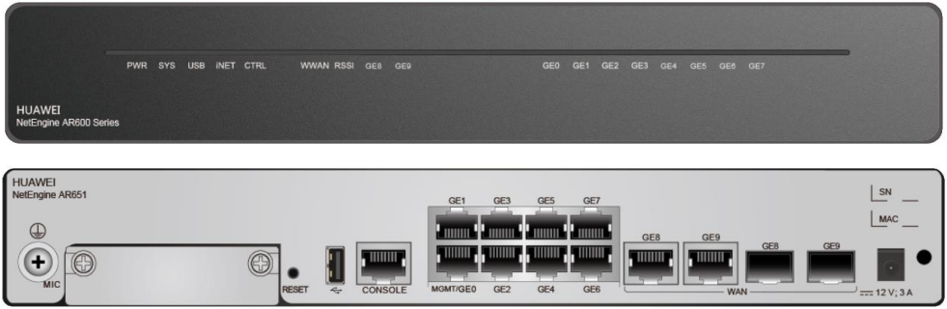
Streamlined USB-based Deployment
USB-based Deployment
Email-based Deployment
DHCP-based Deployment
USB-based deployment allows you to configure devices using a USB flash drive. Before device deployment, save the deployment files in a USB flash drive. After you connect the USB flash drive to a device, the device downloads the files from the USB flash drive to complete version and service deployment. Streamlined USB-based deployment is a type of USB-based deployment.
After a device starts from the initial state, it automatically downloads the configuration file from the USB flash drive for deployment.
Create an index file.
An index file is used to guide device deployment and determine the deployment files to be used.
The index file name must be USB_AR.ini or usb_ar.ini.
Index file
Deployment file
Save the index file and deployment files to the USB flash drive.
Deployment files include the system software, configuration file, patch file, license file, and voice file, which are usually used together with the index file.
Insert the USB flash drive into the device and start the deployment process.
The device automatically restarts.
USB port
Remove the USB flash drive.
Notes:
USB-based deployment is a basic feature of an AR router and is not under license control.
Streamlined USB-based deployment can be used only in the SD-WAN solution. Devices with dual MPUs do not support streamlined USB-based deployment.
Before using an interface on an LPU to perform streamlined USB-based deployment, ensure that the LPU has been registered. If the LPU has not been registered, restart the device before performing simplified USB-based deployment. During the deployment, determine the LPU registration status and deployment status based on the indicator status.
After the deployment is complete, ensure that the devices are placed based on the mappings between the ESNs and sites. Otherwise, the devices may not be able to communicate with the controller.

Slide 26


Making a Deployment Configuration File
USB-based Deployment
Email-based Deployment
DHCP-based Deployment
The process of making a deployment configuration file is divided into two steps:
Generate a ZTP file through the controller.
Use IniConverter to convert the ZTP file into a configuration file.
Configuration file format:
BEGIN
ESN=
CONFIG=
ESN=
CONFIG=
END
Generate
Convert
Generate
Controller
ZTP file
IniConverter
Configuration file

Slide 27
Making a Deployment Index File
USB-based Deployment
Email-based Deployment
DHCP-based Deployment
Use a blank text file to make a deployment index file, which is typically named USB_AR.ini. The index file format is as follows:
BEGIN AR
[USB CONFIG]
SN=20180408.070632 //Data change time identifier, in the format of YYYYMMDD.HHMMSS
EMS_ONLINE_STATE=NO
[UPGRADE INFO]
OPTION=AUTO
DEVICENUM=1
[DEVICE1 DESCRIPTION]
OPTION=OK
ESN=DEFAULT
MAC=DEFAULT
VERSION=DEFAULT
DIRECTORY=DEFAULT
FILENUM=1
TYPE1=SYSTEM-CONFIG-LITE
FILENAME1=ZTP.ini //Name of the configuration file used for deployment
END AR
The field values in red can be modified, and the other field values must be retained.

Slide 28
Checking the Streamlined USB-based Deployment Result
USB-based Deployment
Email-based Deployment
DHCP-based Deployment
Run the display usb usb-id autoupdate state command to check the progress of streamlined USB-based deployment.
In addition, you can observe the USB indicator on the device to determine the status of streamlined USB-based deployment.
If the USB indicator is steady on, streamlined USB-based deployment is completed.
If the USB indicator blinks, streamlined USB-based deployment is in progress.
<Huawei> display usb 1 autoupdate state
Info: Deployment using the USB flash drive is completed successfully.
USB indicator
Notes:
Enable the USB-based deployment function on the device.
[HUAWEI]set usb autoupdate password password # Configure an authentication password for USB-based deployment.
[HUAWEI]autoupdate enable # Enable the USB-based deployment function.
Before running the autoupdate enable command to enable the USB-based deployment function, you must run the set usb autoupdate password command to configure the authentication password for USB-based deployment.

Slide 29









Email-based Deployment
USB-based Deployment
Email-based Deployment
DHCP-based Deployment
During email-based deployment, a network administrator specifies uniform resource locator (URL) parameters in a deployment email to configure deployment information on the controller client and then sends the deployment email to a specified deployment mailbox. A deployment engineer receives the deployment email and clicks the URL in the email to start the deployment process. Subsequently, devices automatically complete the deployment.
Controller
A network administrator configures and sends a deployment email.
Network administrator
The URL used for deployment can also be sent to deployment personnel using methods other than emails, such as a USB flash drive and SMS message.
1
A deployment engineer receives the deployment email.
3
2
Egress
The deployment engineer performs email-based deployment.
Installation engineer
4
Terminals for deployment
Devices connect to the network and register with the controller.
Notes:
Email-based deployment can be used only in SD-WAN solutions.
Email-based deployment applies only to devices with factory settings.
Before email-based deployment, users must not log in to the web UI and change the password. Otherwise, the deployment will fail.
When using the Internet Explorer for email-based deployment, you need to select Use HTTP1.1 on the tab page displayed after you choose Internet Options >Advanced. Otherwise, the deployment will fail.

Slide 30
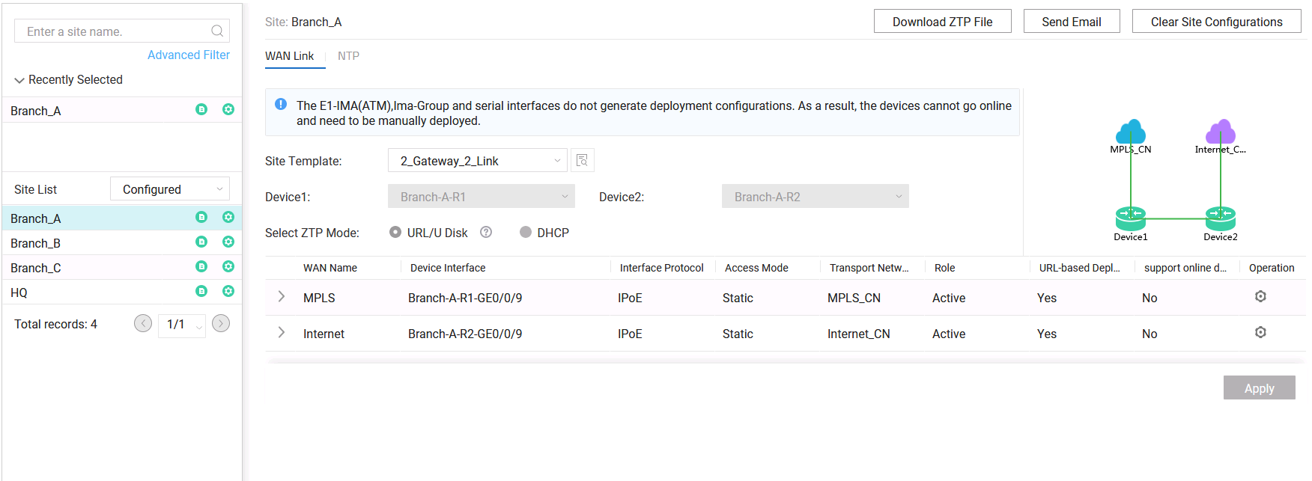
Configuring Email-based Deployment Parameters
USB-based Deployment
Email-based Deployment
DHCP-based Deployment
Configure deployment parameters on the controller.

Slide 31
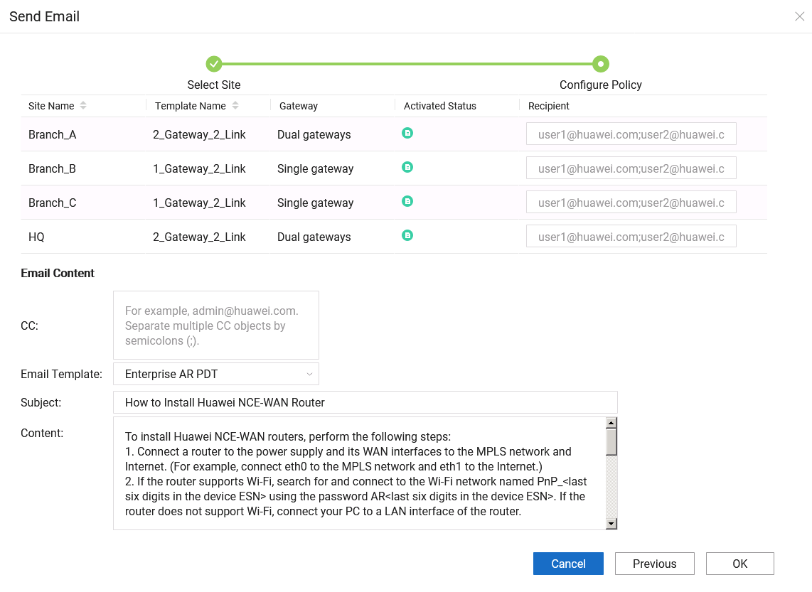
Sending the Deployment Email
USB-based Deployment
Email-based Deployment
DHCP-based Deployment
Send a deployment email and download the ZTP file.

Slide 32
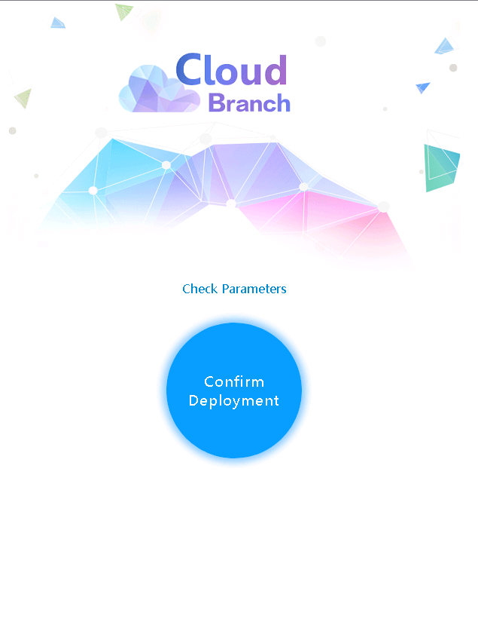
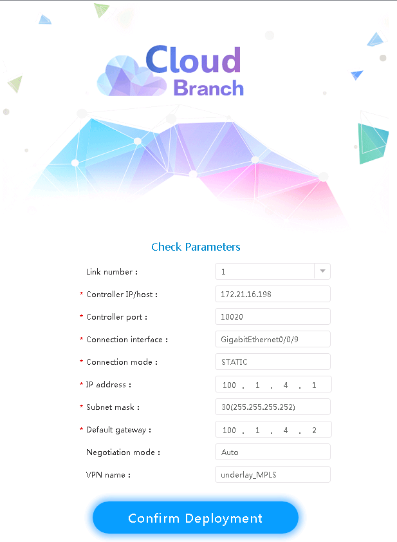
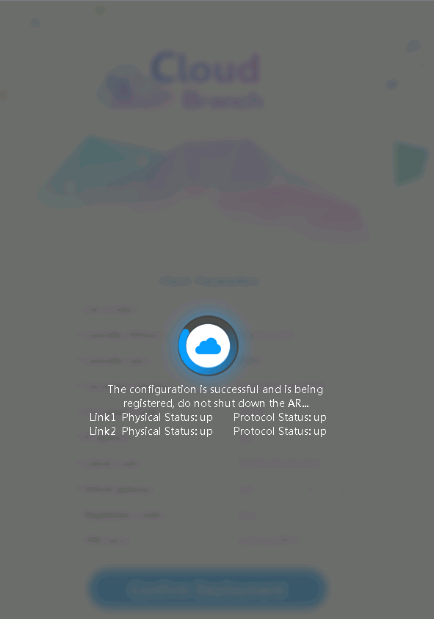
Performing Email-based Deployment
USB-based Deployment
Email-based Deployment
DHCP-based Deployment
A URL in the following format is used for deployment: https://ip/portal?ac_host=ac_host_value&ac_port=ac_port_value...&url_pass=url_pass_value
Notes:
The URL in the deployment email is in the following format: https://ip/portal?ac_host=ac_host_value&ac_port=ac_port_value...&url_pass=url_pass_value
In this format, ... indicates that multiple parameters can be configured, and ip indicates the IP address of the web system. The parameters are separated by ampersands (&). The default web system IP address and subnet mask of the device are 192.168.1.1 and 255.255.255.0, respectively.

Slide 33

DHCP-based Deployment
USB-based Deployment
Email-based Deployment
DHCP-based Deployment
DHCP-based deployment is implemented using the optional fields in DHCP packets. The DHCP server is configured with Option 148, which carries the controller address information. Routers obtain the information through DHCP interaction.
1
Controller
Configure device interconnection parameters on the controller.
Network administrator
1
2
2
Configure DHCP and set the Option 148 field.
DHCP server
3
Devices go online and send DHCP packets to apply for IP addresses.
5
3
4
4
Return DHCP packets that carry the Option 148 field.
Egress
5
Devices register with the controller based on the Option 148 field.

Slide 34
Option 148
USB-based Deployment
Email-based Deployment
DHCP-based Deployment
The Option 148 field is used to notify devices of the controller IP address and port number. The field format is as follows:
option 148 ascii agilemode=tradition;agilemanage-mode=ip;agilemanage-domain=ip-address;agilemanage-port=port-number;
agilemode: indicates the device management mode.
agilemanage-mode: indicates whether a device obtains the URL or IP address of the SD-WAN Controller.
agilemanage-domain: indicates the URL or IP address of the SD-WAN Controller.
agilemanage-port: indicates the port number used by the SD-WAN Controller.

Slide 35
(Multiple-answer question) Which of the following ZTP modes are supported by the device?
USB-based deployment
Email-based deployment
DHCP-based deployment
FTP-based deployment
Notes:
1. ABC

Slide 36
ZTP makes new site deployment more convenient. ZTP can be implemented in the following ways:
Traditional ZTP: Auto-Config, Auto-Start, USB-based deployment
iMaster NCE-WAN-based ZTP: streamlined USB-based deployment, email-based deployment, DHCP-based deployment

Slide 37
Network Management
ZTP
Network Maintenance
Routine maintenance of network devices
Troubleshooting Common Network Device Faults

Slide 38
Device Maintenance Overview
Stable operating of devices depends on a proper network plan and routine maintenance. The purpose of routine maintenance is to discover and eliminate potential threats.
Routine maintenance is complex but mainly involves the following tasks:
Equipment room environment maintenance: Ensure that the temperature and humidity of the equipment room are within the required range.
Device hardware maintenance: Ensure that the devices are clean, with adequate heat dissipation, and the cables and labels comply with the specifications.
Device alarm and configuration maintenance: Ensure that the devices are running properly and the configuration files are normal.

Slide 39
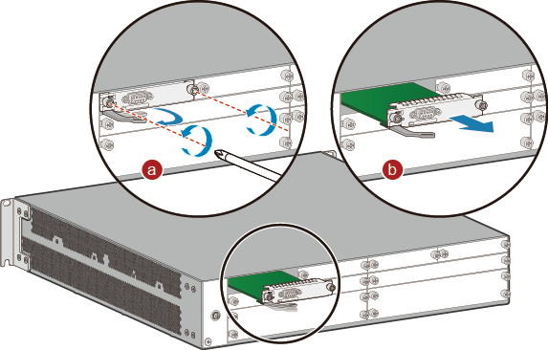
Replacing a Card
Hardware Maintenance
Device Alarm and Configuration Maintenance
Remove cables from the card to be replaced, and record mappings between cables and ports on the card to ensure correct cable connections on the replacement card.
Remove the card.
Loosen the captive screws on both sides of the card and rotate the ejector levers outward.
Gently slide the card out of the slot along the guide rails and place it somewhere safe.
Install the replacement card.
Connect cables to the replacement card according to the recorded mappings between cables and ports on the replaced card.

Slide 40
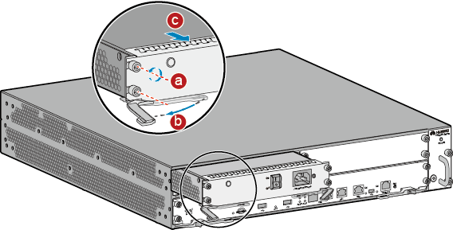
Replacing a Power Module
Hardware Maintenance
Device Alarm and Configuration Maintenance
Check the installation position of the power module to be replaced.
Turn the power switch on the power module to the OFF position.
Uninstall the power module after removing the power cable from it.
Use a Phillips screwdriver to loosen the captive screws on both sides of the power module.
Rotate the ejector levers on the power module outward.
Gently slide the power module out of the slot along the guide rails and place it somewhere safe.
Insert the replacement power module into the slot and connect the power cable to the power module.
Turn the power switch on the power module to the ON position.
Use either of the following methods to check whether the new power module is working properly:
Check the STATUS indicator on the power module. If the indicator is steady green, the power module is working properly.
Run the display device command to check the running status of the new power module.

Slide 41
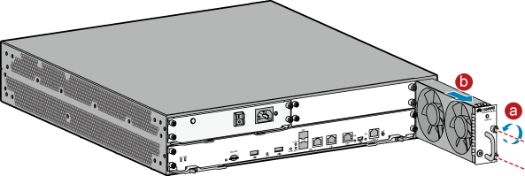
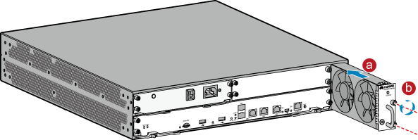
Replacing a Fan Module
Hardware Maintenance
Device Alarm and Configuration Maintenance
Remove a fan module.
Use a Phillips screwdriver to loosen the captive screws on the fan module to be replaced.
Grasp the handle of the fan module and pull out part of the fan module. Wait until the fans stop running, and then pull the fan module completely out of the slot.
Install a new fan module.
Hold the handle of the fan module with one hand and support its bottom with the other hand. Slowly slide the fan module into the slot along the guide rails, until it is completely attached to the chassis backplane.
Use the Phillips screwdriver to tighten the captive screws on the fan module.

Slide 42
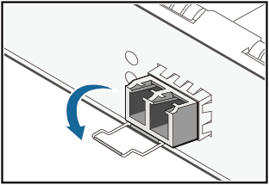
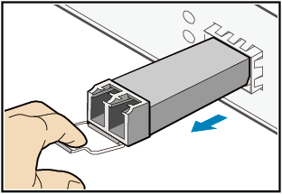
Replacing an Optical Module
Hardware Maintenance
Device Alarm and Configuration Maintenance
Mark the positions of the Tx and Rx optical fibers on the bores of the optical module to be replaced, and then remove the optical fibers.
Cover the removed optical fibers with dust caps.
Remove the optical module.
Securely insert the replacement optical module into the optical port.
Connect the Tx and Rx optical fibers to the optical module based on the marks.
Check the LINK indicator on the optical port. If the indicator turns green, the new optical module works properly.

Slide 43
Device Alarms and Logs
Hardware Maintenance
Device Alarm and Configuration Maintenance
During the operating of a device, its running status and configuration change. The device generates different types of information based on these changes.
A device generates three types of information: logs, traps, and debugging messages.
Different types of information carry different contents:
Information Type | Content Description
Logs | Logs record user operations, system faults, and system security. There are three types of logs: user logs, security logs, and diagnostic logs. User logs record user operations and system operating information. Security logs record security information, including information about user account management, protocols, attack defense, and status. Diagnostic logs record information used for locating faults.
Traps | Traps are notifications generated when the system detects faults. They record system status information. Unlike logs, traps are time-sensitive because they need to be sent to administrators in a timely manner.
Debugging message | Debugging messages show internal operating information of the system. They are mainly used to trace the device running status. Debugging messages are generated only after the debugging function of a module is enabled.

Slide 44
Severity Levels of Device Information
Hardware Maintenance
Device Alarm and Configuration Maintenance
When a large amount of information is generated, it is difficult to differentiate between information about normal operations and information about faults. By assigning severity levels to information, users can perform a rough analysis of information based on the severity levels and screen out unwanted information.
There are eight severity levels, each identified by a number. A smaller number indicates a higher severity level.
Number Displayed | Severity Level | Description
0 | Emergencies | A fault that makes the device unable to run normally unless it is restarted. For example, the device restarts due to a program exception or an error in memory usage.
1 | Alert | A major fault that needs to be rectified immediately. For example, the memory usage of the system reaches the upper limit.
2 | Critical | A fault that needs to be analyzed and processed. For example, the memory usage of the device falls below the lower threshold, or BFD detects that the device is unreachable.
3 | Error | An incorrect operation or service processing exception that does not affect services but needs to be analyzed. For example, users enter incorrect commands or passwords, or error protocol packets are received.
4 | Warning | An anomaly that occurs when a device is operating and requires attention because it may cause service processing faults. For example, a routing process is disabled, BFD detects packet loss, or error protocol packets are detected.
5 | Notification | A key operation that is performed to ensure normal operation of the device. For example, an interface is shut down, a neighbor is discovered, or the protocol state machine status changes.
6 | Informational | A common operation that is performed to ensure normal operation of the device. For example, the display command is run.
7 | Debugging | Common information that is generated during normal operation of the device, which requires no attention.

Slide 45
Device Information Output
Hardware Maintenance
Device Alarm and Configuration Maintenance
Information generated by a device can be displayed on a remote terminal, console, log buffer, log file, or SNMP agent. To allow information to be displayed in correct places, the information center defines 10 information channels, which work independently from one another.
Information Type
Information Channel
Output Direction
Console
Console
Monitor
Remote terminal
Logs
Loghost
Log host
Trapbuffer
Trap buffer
Traps
Logbuffer
Log buffer
Debugging message
SNMP Agent
SNMP agent
Channel 6
Channel 7
Channel 8
Channel 9
Log file
Notes:
To check logs recorded in the log buffer, run the display logbuffer command.
To check information in log files, run the display logfile [file-name] command .
To check traps recorded in the trap buffer, run the display trapbuffer [ size value ] command.

Slide 46
Device Software Upgrade
Hardware Maintenance
Device Alarm and Configuration Maintenance
Upgrading device software can fix some software bugs and add new functions to devices. Device upgrade is a high-risk operation, and you need to make the following preparations before a device upgrade:
Back up key files, such as system configuration files, old system software, patch files, and license files.
Record network status, such as the number of neighbors and the number of routing entries.
Manually specify the startup file and restart the device.
Software can be upgraded in either of the following modes:
Use commands.
Upload files (system software, patches, and license files) using commands.
Specify startup files (system software, patches, and license files) using commands.
Restart a device and check whether the upgrade is successful and whether the network is in normal state.
Upload files using FTP/SFTP/TFTP
Upgrade files
Device to be upgraded
Network administrator
Manually check the upgrade result.
Manually specify the startup file using the NMS or controller and restart the device.
Use the NMS software or controller.
Upload the files to the NMS/controller.
Upgrade the device system using the controller.
Check whether the upgrade is successful and whether the network is in normal state.
Upload files to the NMS/controller.
Deliver files to the device.
Upgrade files
Upgrade files
Device to be upgraded
Network administrator
NMS software/Controller
Manually check the upgrade result.
Notes:
Specify the system software for the next startup:
startup system-software system-file [ verify | signature sign-filename ]
Verify: checks the validity of the system software content.
Signature: checks the validity of the digital signature file of the system software.
Specify the patch file for the next startup.
startup patch patch-name

Slide 47
Saving Configuration Files
Hardware Maintenance
Device Alarm and Configuration Maintenance
During routine maintenance, network device configurations are periodically backed up to ensure that the network can be quickly restored in case of a fault. Configurations can be backed up using any of the following methods:
Manual backup: manually saves configuration files on the local PC.
Automatic backup: automatically saves configuration files on the local PC.
NMS software/controller-based backup: The NMS software/controller collects device configurations and saves them locally.
Configuration files can be stored on the local device, FTP server, NMS, or controller.
<Huawei> save [ all ] [ configuration-file ]
<Huawei> autosave interval { value | time | configuration time } //Automatically backs up data at intervals.
<Huawei> autosave time { value | time-value } //Automatic backs up data at scheduled time.

Slide 48
(Multiple-answer question) Which of the following files are involved in device upgrade?
System software
Patch file
Routing table file
License file
Notes:
1. ABD

Slide 49
Routine maintenance involves the following tasks:
Equipment room environment maintenance
Device hardware maintenance
Device alarm and configuration maintenance

Slide 50
Network Management
ZTP
Network Maintenance
Routine Maintenance of Network Devices
Troubleshooting Common Network Device Faults

Slide 51
Common Network Troubleshooting Commands
A network fault may cause packet loss or service interruption. To diagnose a network fault, you can run the following commands to identify the causes:
display: displays the device status, entries, and configurations. This command is most commonly used for locating faults.
ping: used to check network connectivity and preliminarily identify the cause of network interruption.
tracert: used to check network connectivity and preliminarily identify the cause of network interruption.
debugging: used to analyze the causes of network faults based on data packets.

Slide 52
Procedure for Troubleshooting an Interface Physically Down Issue
Interface Physically Down
Ping Failure
Packet Loss
Password Recovery
Hardware and software failures are major causes of an interface physically Down issue.
Hardware failures: include failures of hardware such as cards, interfaces, optical modules, fibers, and network cables on the local and remote devices.
Software failures: include inconsistent configurations, such as the negotiation mode, rate, and duplex configuration of interfaces on the local and remote devices.
To troubleshoot the interface physically Down issue, you can use the 4M1E method (Man, Machine, Material, Method, and Environment in sequence) to locate the root cause and rectify the fault.
Man: incorrect removal of network cables, configuration error
Machine: card and interface faults on the device
Material: loose RJ45 connector, aged network cable, optical module exception, etc.
Method: mismatch between optical fibers and optical modules, and between optical modules and interfaces
Environment: high- and low-current cables are routed in parallel; media damage caused by hash environment

Slide 53
Interface Physically Down - Man
Interface Physically Down
Ping Failure
Packet Loss
Password Recovery
Check whether improper operations are performed recently, such as incorrect removal and installation of network cables, loose cable connections caused by accidental touch, and misconfigurations.
Run the display interface interface-type interface-number command to check the status of an interface.
[Branch-A-1]display interface g0/0/0
GigabitEthernet0/0/0 current state : Administratively DOWN
Line protocol current state : DOWN
Description:HUAWEI, AR Series, GigabitEthernet0/0/0 Interface
Switch Port, PVID : 1, TPID : 8100(Hex), The Maximum Frame Length is 9600
IP Sending Frames' Format is PKTFMT_ETHNT_2, Hardware address is 1c20-dbde-7020
Last physical up time : -
Last physical down time : 2020-04-21 14:07:03
Current system time: 2020-05-13 08:00:21
Port Mode: COMMON COPPER
Speed : 1000, Loopback: NONE
Duplex: FULL, Negotiation: ENABLE
Mdi : AUTO, Clock : -
Last 300 seconds input rate 0 bits/sec, 0 packets/sec
Last 300 seconds output rate 0 bits/sec, 0 packets/sec
Input peak rate 0 bits/sec,Record time: -
Output peak rate 0 bits/sec,Record time: -
Notes:
Recovery method:
If the current state value is Administratively down, the interface is manually shut down. In this case, run the undo shutdown command on the interface.
If the current state value is Down, check whether interfaces on both ends of the link have the same rate, duplex mode, and auto-negotiation mode.
If the Negotiation value is ENABLE, the interface works in auto-negotiation mode and the rate and duplex mode are negotiated by interfaces on both ends of the link. If the two interfaces have different rates or duplex modes, run the restart command to restart the interfaces so that they can negotiate the rate or duplex mode again. If the negotiation fails, run the undo negotiation auto command to configure the interface to work in non-auto negotiation mode. For the rate and duplex mode configurations, see the step below.
If the Negotiation value is DISABLE, the interface works in non-auto-negotiation mode. You can run the speed { 10 | 100 | 1000 } and duplex { full | half } commands in the interface view to adjust the configurations, so that the interfaces on both ends of the link can have the same rate and duplex mode.

Slide 54
Notes:
If the current state value is ERROR DOWN (down-cause), check whether the interface is shut down due to an error event. You need to rectify the fault according to the down-cause field.

Slide 55
Interface Physically Down - Machine
Interface Physically Down
Ping Failure
Packet Loss
Password Recovery
If a card or an interface is faulty, the physical status of the interface becomes Down. Therefore, it is important to troubleshoot hardware faults of the device.
You can run the display interface brief command to check brief information about the status and configuration of all interfaces.
If many interfaces change from Up to Down, a card fault may occur. If a single interface changes from Up to Down, check whether the interface is damaged. If the interface is in good condition, run the loopback internal command to check whether a hardware fault occurs on the interface.
<HUAWEI> display interface brief
Interface PHY Protocol InUti OutUti inErrors outErrors
GigabitEthernet0/0/0 down down 0% 0% 0 0
GigabitEthernet0/0/1 up up 0.01% 0% 0 0
GigabitEthernet0/0/2 down down 0% 0% 0 0
GigabitEthernet0/0/3 up up 0.01% 0% 0 0
GigabitEthernet0/0/4 down down 0% 0% 0 0
<HUAWEI> system-view
[HUAWEI] interface gigabitethernet 0/0/1
[HUAWEI-GigabitEthernet0/0/1] loopback internal
[HUAWEI-GigabitEthernet0/0/1] display this interface
GigabitEthernet0/0/1 current state : UP
Line protocol current state : UP
Notes:
Recovery method:
Multiple interfaces are physically Down.
If multiple interfaces on a same card become physically Down and these interfaces are connected to multiple properly-working peer devices, this card may be faulty. In this case, run the reset slot slot-id command to reset the card. If the fault persists, replace the card.
If multiple interfaces become physically Down and these interfaces connect the local device to the same peer device, the peer device may be faulty. You need to log in to the peer device to check whether the corresponding card is faulty. If so, reset or replace it. If an active/standby switchover is performed on the peer device, or if the peer device is in sleeping state or restarted, it is a normal situation that these interfaces become physically Down. These interfaces will automatically change to the Up state once the peer device becomes stable.
A single interface is physically Down.
If only one interface is physically Down, check whether the interfaces at both ends of the link have hardware faults such as locking tab dents. If the interface is faulty, use another idle interface.

Slide 56
Interface Physically Down - Material
Interface Physically Down
Ping Failure
Packet Loss
Password Recovery
Physical interfaces can be electrical or optical. The transmission media include RJ45 network cables, optical modules, and optical fibers. When a transmission medium is aged or damaged, or when the optical module fails to transmit or receive optical signals, the interface goes Down physically.
Perform the following steps to check whether an electrical interface is faulty:
Check whether cables are connected correctly.
Check whether the cable length and specification comply with related standards.
Check the status of wire pairs in a cable.
Run the virtual-cable-test command.
Perform the following steps to check whether an optical interface is faulty:
Check whether the optical module is Huawei-certified.
Check whether the optical module is in normal state.
Run the display transceiver interface command.
<HUAWEI> display transceiver interface gigabitEthernet 2/0/3 verbose
Diagnostic information: Temperature (°C) :39
Voltage(V):3.32
Bias Current(mA):6.91 //Current
Bias High Threshold(mA):33.34
Bias LowThreshold(mA):1.67
Current Rx Power(dBM):-4.59 //Receive power of the interface
Default Rx Power High Threshold(dBM):0.00
Default Rx Power LowThreshold(dBM):-16.99
Current Tx Power(dBM):-5.10 //Transmit power of the interface
Default Tx Power High Threshold(dBM):0.00
Default Tx Power LowThreshold(dBM):-12.50
[HUAWEI] interface gigabitethernet 0/0/1
[HUAWEI-GigabitEthernet0/0/1] virtual-cable-test
Pair A length: 1meter(s)
Pair B length: 1meter(s)
Pair C length: 1meter(s)
Pair D length: 1meter(s)
Pair A state: Ok
Pair B state: Ok
Pair C state: Ok
Pair D state: Ok
Notes:
Recovery method:
Connection media failures of electrical interfaces
If the network cable connected to an electrical interface is faulty, replace the network cable.
Connection media failures of optical interfaces
If the transmit power is too high or too low, replace the optical module.
If the receive power is too high or too low, use an optical power meter to measure the attenuation of each part of the link and fix the part where an exception is detected. If the fault persists, replace the optical module or optical fiber. Ensure that the transmission distance of the optical module and the type of the optical fiber meet the networking requirements.

Slide 57
Interface Physically Down - Method
Interface Physically Down
Ping Failure
Packet Loss
Password Recovery
When performing operations on the connection media between devices, you need to check whether the optical module matches the optical interface, whether the optical module matches the optical fiber model, and whether the optical module is correctly connected to the optical fiber.
Run the display transceiver interface command to check whether the optical module parameters at both ends of the link are consistent.
Run the display interface interface-type interface-number command to check whether the interface is a combo interface and whether it is working in the correct mode.
<HUAWEI> display transceiver interface GigabitEthernet 0/0/1 verbose
GigabitEthernet0/0/1 transceiver information:
Common information: Transceiver Type:1000_BASE_SX_SFP
Connector Type:LC
Wavelength(nm):850
Transfer Distance(m):500(50um),300(62.5um)
Digital Diagnostic Monitoring:YES
Vendor Name:HUAWEI
Vendor Part Number:02315204
<HUAWEI> display interface gigabitethernet 1/0/1
GigabitEthernet1/0/1 current state : DOWN
Line protocol current state : DOWN
Description:HUAWEI, Quidway Series, GigabitEthernet1/0/1 Interface
……
Port Mode: COMBO AUTO
Current Work Mode: COPPER
Speed : 100, Loopback: NONE
Notes:
Recovery method:
Ensure that the optical module in use matches the optical interface and optical fiber. Replace them if they do not match.
If the interface is a combo interface, ensure that the working mode of the combo interface is the same as the actual working mode of the interface.

Slide 58
Interface Physically Down - Environment
Interface Physically Down
Ping Failure
Packet Loss
Password Recovery
Network devices are used in various scenarios and can be located at any layer of a network. When a device and its connection media are abnormal due to environmental factors, its interface may also be physically Down.
Check the temperature and humidity of the equipment room.
For most network devices, the operating temperature is in the range 0℃ to 45℃, and the relative humidity is in the range 5% RH to 95% RH (non-condensing).
Check cabling.
Power cables and service cables are routed separately. Low-current cables must be separated from high-current cables to prevent interference. Check whether network cables are damaged or aged out because of high temperature or rack wear.
Notes:
Recovery method:
If the temperature in the equipment room fails to meet the requirement for a long time, repair or replace the air conditioning system. If the relative humidity of the equipment room is high, install a dehumidifier. If the relative humidity of the equipment room is low, install a humidifier.
If high-current and low-current cables are routed in parallel, re-route the cables to separate them. If network cables are damaged or aged out due to environmental factors, replace the cables.

Slide 59
Troubleshooting a Ping Failure
Interface Physically Down
Ping Failure
Packet Loss
Password Recovery
A ping failure occurs when a device fails to receive any ping response packet due to reasons such as a link fault or ARP learning failure.
The ping operation involves three types of devices: source device, intermediate device, and destination device.
When the source device RTA fails to ping Net1, it is difficult to determine the cause of the fault. In this case, you can narrow down the fault scope. To be specific, ping RTB, RTC, and RTD one by one from RTA. If you still cannot locate the network segment where the fault occurs, ping RTC and RTD from RTB, and so forth. Stop the ping operation when you can determine the network segment where the fault occurs.
Source device
Intermediate device
Destination device
Net1
RTA
RTB
RTC
RTD

Slide 60
Checking Whether the Ping Command Is Correct
Interface Physically Down
Ping Failure
Packet Loss
Password Recovery
The ping command provides many parameters. You can select appropriate parameters based on factors such as the detection purpose, network type, and network status.
Check whether the ping –f ip-address command is run on the device. If the command is run, ICMP packets cannot be fragmented, so you need to check the MTU on the outbound interface of the link.
For details about the ping command format, see the description of the ping command format in the product documentation.

Slide 61
Checking the Status of the Physical Link
Interface Physically Down
Ping Failure
Packet Loss
Password Recovery
Check the indicator status on an interface. If the indicator is off, the interface is not connected. In this case, try another interface or network cable.
Check whether an optical fiber or network cable is connected to correct interfaces as required in the network deployment plan. If not, connect it to the required interfaces.
Ensure the wavelengths of optical modules used at both ends are consistent. It is recommended that Huawei-certified optical modules be used.
For details about how to rectify the fault when a physical link goes Down, see the part "Troubleshooting the Interface Physically Down Issue".

Slide 62
Checking the Routing Table
Interface Physically Down
Ping Failure
Packet Loss
Password Recovery
Before checking the routing table, you need to check whether the terminal is configured with the correct gateway address.
The routing table is the most important basis for data forwarding. You can run the display ip routing-table ip-address command to check whether there are correct routes on the device.
In addition to the routing table, policy-based routing also affects data forwarding. Policy-based routing takes priority over the routing table. You can run the display traffic-policy applied-record command to check the application information of traffic policies.
<Branch-A-1>display ip routing-table
Destination/Mask Proto Pre Cost Flags NextHop Interface
0.0.0.0/0 Static 60 0 RD 202.1.2.2 GigabitEthernet0/0/9
172.21.16.197/32 Static 60 0 RD 202.1.2.2 GigabitEthernet0/0/9
172.21.16.198/32 Static 60 0 D 202.1.2.2 GigabitEthernet0/0/9
202.1.2.0/30 Direct 0 0 D 202.1.2.1 GigabitEthernet0/0/9
202.1.2.1/32 Direct 0 0 D 127.0.0.1 GigabitEthernet0/0/9
202.1.2.3/32 Direct 0 0 D 127.0.0.1 GigabitEthernet0/0/9
<SwitchB> display traffic-policy applied-record
-------------------------------------------------
Policy Name: p1
Policy Index: 0
Classifier:c1 Behavior:b1
-------------------------------------------------
*interface GigabitEthernet1/0/2
traffic-policy p1 inbound
slot 1 : success
-------------------------------------------------
Policy total applied times: 1.

Slide 63
Checking Whether ARP Entries Are Correctly Learned
Interface Physically Down
Ping Failure
Packet Loss
Password Recovery
ARP entries play a decisive role in data encapsulation. Incorrect ARP entries will result in data encapsulation error or failure.
Run the display arp all command to check whether the ARP entry of the directly connected address is correctly learned.
If MAC ADDRESS is Incomplete in the output, the ARP entry is temporary and the correct ARP entry is not learned. An ARP entry is learned successfully if a correct MAC address is displayed under MAC ADDRESS.
Run the display mac-address interface-type interface-number command to view the MAC address entry and check whether the outbound interface of the entry is the same as that in the ARP entry. If they are different, check whether a loop or MAC address conflict occurs.
<Huawei> display arp all
IP ADDRESS MAC ADDRESS EXPIRE(M) TYPE VLAN INTERFACE VPN-INSTANCE
------------------------------------------------------------------------------
192.168.1.10 4c1f-cc17-1ca5 I - Vlanif10
192.168.1.11 4c1f-cc2f-3634 10 D-0 GE1/0/1
192.168.40.1 incomplete
------------------------------------------------------------------------------
Total:2 Dynamic:1 Static:0 Interface:1

Slide 64
Checking Whether ICMP Packets Are Sent and Received Correctly
Interface Physically Down
Ping Failure
Packet Loss
Password Recovery
Ping packets may be damaged during transmission. You can run the display icmp statistics command to check statistics about ICMP packets.
<Huawei> display icmp statistics
Input: bad formats 0 bad checksum 0
echo 0 destination unreachable 0
source quench 0 redirects 0
echo reply 25 parameter problem 0
timestamp request 0 information request 0
mask requests 0 mask replies 0
time exceeded 0 timestamp reply 0
Mping request 0 Mping reply 0
Output:echo 25 destination unreachable 0
source quench 0 redirects 0
echo reply 0 parameter problem 0
timestamp request 0 information reply 0
mask requests 0 mask replies 0
time exceeded 0 timestamp reply 0
Mping request 0 Mping reply 0
Notes:
Check whether the value of bad checksum before and after a ping operation. If the value increases, check whether the ICMP packets returned by the protocol stack on the remote device have the correct format.
If the values of echo and echo reply are the same, but the ping still fails, check ICMP packet statistics to determine whether ICMP packets are successfully sent and received.
If the values of echo and echo reply are different:
If the number of echo request packets sent by the local device is smaller than the number of packets sent by the ICMP module, packets are discarded by the local device.
If the number of echo request packets sent by the local device is larger than the number of echo request packets received by the remote device, packets are discarded during transmission.
If the number of echo request packets sent by the local device is the same as the number of echo request packets received by the remote device, but the number of echo reply packets sent by the remote device is smaller than the number of echo request packets received by the remote device, packets are discarded by the remote device.

Slide 65
Checking Whether Ping Packets Are Discarded Due to CPCAR Exceeding
Interface Physically Down
Ping Failure
Packet Loss
Password Recovery
Control Plane Committed Access Rate (CPCAR) limits the rate of protocol packets sent to the CPU based on the protocol type, preventing excess packets of a protocol from being sent to the CPU.
Ping packets may be discarded when the packet rate exceeds the CPCAR value. You can run the display cpu-defend statistics packet-type icmp all command to check the number of ping packets discarded due to CPCAR being exceeded.
<HUAWEI> display cpu-defend statistics packet-type icmp all
Statistics on mainboard:
-------------------------------------------------------------------------------
Packet Type Pass(Bytes) Drop(Bytes) Pass(Packets) Drop(Packets)
-------------------------------------------------------------------------------
icmp 4488 0 44 0
-------------------------------------------------------------------------------
Statistics on slot 3:
-------------------------------------------------------------------------------
Packet Type Pass(Bytes) Drop(Bytes) Pass(Packets) Drop(Packets)
-------------------------------------------------------------------------------
icmp 0 0 0 0
-------------------------------------------------------------------------------
Notes:
If the Drop value keeps increasing during the ping operation, packets are discarded due to CPCAR being exceeded. Increase the CPCAR value and perform a ping test again to check whether the fault is rectified.

Slide 66
Troubleshooting Packet Loss
Interface Physically Down
Ping Failure
Packet Loss
Password Recovery
When packet loss occurs, determine the location where packets are dropped, analyze the cause of the packet loss, and then rectify the fault accordingly.
Symptoms of packet loss:
The Internet access speed is unstable. Web pages are displayed at a low speed, or some parts of web pages or even the entire web pages cannot be displayed sometimes.
Pixelation, artifacts, or frame freezing occurs when a user watches video.
Users are frequently logged out of instant messaging tools such as WhatsApp, or login times out.
Files are downloaded at a low speed.
D
C
B
A
D
B
A
D
A
Net1
User A
RTA
RTB
C
RTC
B
RTD
Packet loss
Packet loss

Slide 67
Checking the Status of the Physical Link
Interface Physically Down
Ping Failure
Packet Loss
Password Recovery
Check the indicator status on an interface. If the indicator is off, the interface is not connected. In this case, try another interface or network cable.
Check whether an optical fiber or network cable is connected to correct interfaces as required in the network deployment plan. If not, connect it to the required interfaces.
Ensure the wavelengths of optical modules used at both ends are consistent. It is recommended that Huawei-certified optical modules be used.
For details about how to rectify the fault when a physical link goes Down, see the part "Troubleshooting the Interface Physically Down Issue".

Slide 68
Checking for CRC Errors in the Inbound Direction of an Interface
Interface Physically Down
Ping Failure
Packet Loss
Password Recovery
A Cyclic Redundancy Check (CRC) is an error-detecting code commonly used on communications devices to determine if a block of data has been corrupted.
Run the display interface interface-type interface-number command to check the CRC error count. If the CRC error count keeps increasing, packet loss is caused by a link or device fault.
[Huawei]display interface g0/0/0
…
Last 300 seconds input rate 0 bits/sec, 0 packets/sec
Last 300 seconds output rate 0 bits/sec, 0 packets/sec
Input peak rate 0 bits/sec,Record time: -
Output peak rate 0 bits/sec,Record time: -
Input: 0 packets, 0 bytes
Unicast: 0, Multicast: 0
Broadcast: 0, Jumbo: -
Discard: 0, Total Error: 0
CRC: 0, Giants: 0
Jabbers: 0, Throttles: 0
Runts: 0, Symbols: 0
Ignoreds: 0, Frames: 0

Slide 69
Checking the Number of Discarded Packets in the Outbound Direction of an Interface
Interface Physically Down
Ping Failure
Packet Loss
Password Recovery
The Discard field records the number of packets discarded on an interface. The most common cause of packet loss on an interface is that the interface is congested.
Run the display interface interface-type interface-number command to view the number of discarded packets in the outbound direction of the interface.
[Huawei]display interface g0/0/0
GigabitEthernet0/0/0 current state : DOWN
Line protocol current state : DOWN
……..
Output: 0 packets, 0 bytes
Unicast: 0, Multicast: 0
Broadcast: 0, Jumbo: -
Discard: 0, Total Error: 0
Collisions: 0, ExcessiveCollisions: 0
Late Collisions: 0, Deferreds: 0
Input bandwidth utilization threshold : 100.00%
Output bandwidth utilization threshold: 100.00%
Input bandwidth utilization : 0%
Output bandwidth utilization : 0%
Notes:
If packet loss occurs, use the following methods to optimize the network:
Increase the port capacity.
If multiple flows conflict, increase the link bandwidth between devices or add more ports to the Eth-Trunk for load balancing.
Configure traffic rate limiting or shaping in the inbound direction.
Traffic burst is the major cause of unexpected packet loss. When the burst packet size exceeds the port buffer limit, service packets are discarded, affecting user services. Configuring traffic rate limiting or traffic shaping on the upstream device can relieve traffic burst or reduce the burst packet size, lowering the possibility of congestion-triggered packet loss on downstream devices.
Configure differentiated services on an interface, so that key services are placed in high-priority queues and processed preferentially in case of congestion.
Typically, an interface may carry many services, including high-priority services (such as voice and video) and low-priority services (such as Internet access). You can specify different priorities for high-priority services on the upstream device or configure priority mapping in the inbound direction of a device, so that key services enter the high-priority queues. Configuring PQ scheduling in the outbound direction can ensure that high-priority services are scheduled first.
If multicast services are configured on a device, adjust the packet sending mode on the multicast source server to mitigate the congestion.

Slide 70
Checking for Loops
Interface Physically Down
Ping Failure
Packet Loss
Password Recovery
Loops are the most common and difficult-to-detect factor that leads to packet loss. You can check for loops using any of the following methods:
Run the display interface brief | include up command to check the traffic on all interfaces in Up state.
Run the display interface interface-type interface-number command to check whether there are a large number of broadcast packets on the interface.
Run the display cpu-usage command to check whether the CPU usage exceeds 80%.
<Huawei> display interface brief | include up
Interface PHY Protocol InUti OutUti inErrors outErrors
GigabitEthernet0/0/2 up up 76% 76% 0 0
[Huawei]display interface g0/0/0
Input: 0 packets, 0 bytes
Unicast: 0, Multicast: 0
Broadcast: 0, Jumbo: -
Discard: 0, Total Error: 0
[Huawei]display cpu-usage
Control Plane
CPU Usage: 5.3% Max: 50.7%
User: 0.0% System: 0.0% SoftIrq: 0.0% HardIrq: 0.0% Idle: 94.7%
CPU utilization for ten seconds: 5.3% one minute: 4.0% five minutes: 4.0% ..
Notes:
For a Layer 2 network, run the display mac-address flapping record command to check whether MAC address flapping occurs, so as to determine whether there are loops.
Choose from the following methods based on the loop information and networking.
Observe interface indicators and collect traffic statistics on interfaces to locate the interfaces experiencing broadcast storms.
Check the devices hop by hop according to the topology to locate the devices that cause the loop.
Locate the interfaces that cause the loop and shut down the interfaces to remove the loop. Shutting down interfaces can prevent loops, but you need to determine the cause of a loop after the loop is eliminated.

Slide 71
Checking for Attacks
Interface Physically Down
Ping Failure
Packet Loss
Password Recovery
When undergoing an attack, a device is busy processing requests from the attack source, and therefore drops packets of other services.
Common network attacks, such as ARP, ARP Miss, and DHCP attacks, can cause a high CPU usage on a device. These attacks are all initiated by sending a large number of protocol packets; therefore, packet statistics on the device show a large number of packets are sent to the CPU.
Run the display cpu-defend statistics command to view statistics about the packets sent to the CPU, and determine whether too many protocol packets are discarded due to timeout.
[Branch-A-1]display cpu-defend statistics
-----------------------------------------------------------------------
Packet Type Pass Packets Drop Packets
-----------------------------------------------------------------------
8021X 0 0
8021X-first 0 0
arp-miss 1 0
arp-reply 3189 0
arp-request 1106 0
…
Notes:
You can use the attack source tracing function to locate the attack source, and then create and apply a local attack defense policy based on the attack source.

Slide 72
Password Recovery
Interface Physically Down
Ping Failure
Packet Loss
Password Recovery
You can log in to a device through the console port or Telnet. If login fails in either mode, use the other method and then change your password. If console- and Telnet-based login both fails, change your password through BootROM.
Connect to the device using a serial cable, and restart the device. When the message "Press Ctrl+B to break auto startup ..." is displayed, press Ctrl+B, and then enter the password to access the BootROM main menu.
If the console login password, Telnet login password, and BootROM password are all forgotten, contact Huawei technical support.
1
Main Menu
1. Default Startup
2. Serial Menu
3. Network Menu
4. Startup Select
5. File Manager
6. Reboot
7. Password Manager
Enter your choice(1-7):7
2
PassWord Menu
1.Modify the menu password
2. Clear the console login password
0. Return
Enter your choice(0-2):2
Notes:
To access the BootROM menu, you must restart the device, which results in service interruption. Migrate services to a backup device and perform this operation during off-peak hours.
If you have cleared the console login password, configure a new password immediately after login. Otherwise, you must clear the console password again to log in if the login timeout timer expires or the device restarts.
Do not power off the device during the operation.
In V200R003C01 and earlier versions, the default BootROM password is huawei. In V200R005C00 and later versions, the default BootROM password is Admin@huawei.

Slide 73
In the cloud computing era, SNMP is no longer suitable for managing large-scale networks due to its disadvantages in configuration and status collection functions. The NETCONF protocol and telemetry technology are developed to solve these problems. NETCONF facilitates device configuration on the NMS and controller, whereas telemetry technology accelerates device status collection.
When a large number of sites need to be deployed, the traditional deployment mode requires a large amount of manpower. ZTP is the best choice in this scenario as it can be used to quickly deploy devices.
Routine network maintenance includes equipment room environment maintenance, device hardware maintenance, and device alarm and configuration maintenance.

